Slide 1
Project Management:
Process, Technology, and Practice
Ganesh Vaidyanathan
Chapter 5
Planning

Slide 2
Learning objectives
Manage the planning process of a project
Understand the work breakdown structure of a project
Understand different types of contracts in a project
Understand procurement management
Decide on make versus buy and rent versus lease

Slide 3
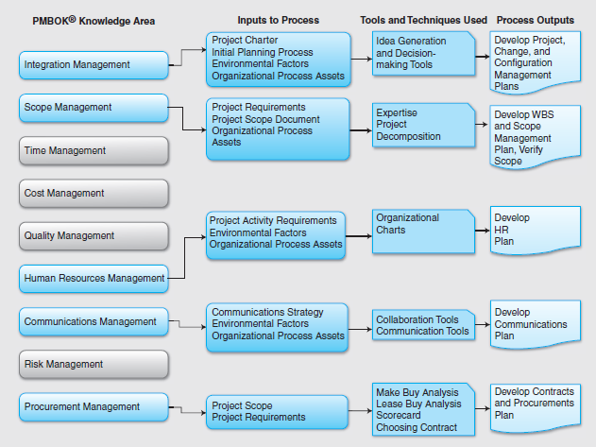

Slide 4
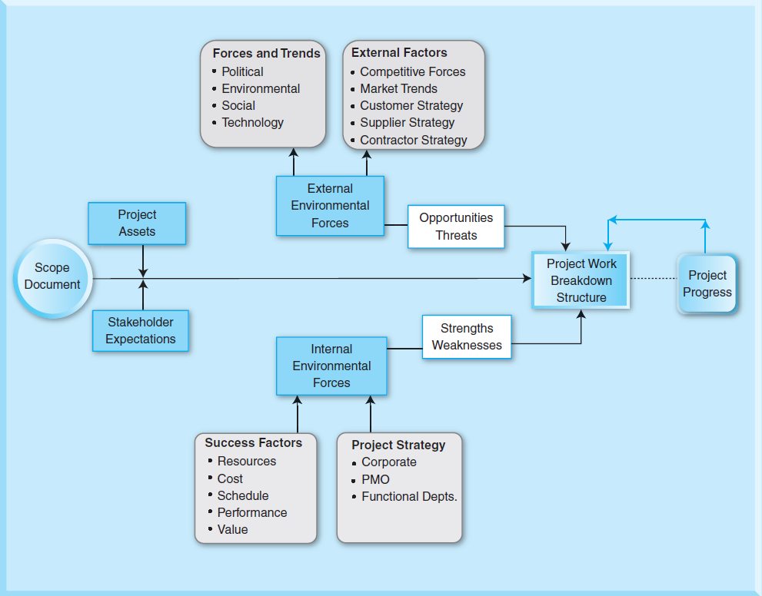
Planning process

Slide 5
Project Planning
Planning helps project managers:
Clarify and focus a project's development and prospects.
Provide a benchmark against which actual performance can be measured and reviewed.

Slide 6
Organizational Process Assets
Organizational Process Assets
Any process-related assets that can be used towards a project’s success that include:
Existing policies, procedures, guidelines and templates;
Resources and knowledge of prior projects
Knowledge of technologies, outsourcing, information systems, management systems, and financial systems
Organizational controls
Prior project documents

Slide 7
Documents during project planning
Customer requirements: Requirements that satisfy the needs of the customers and the end users
Specifications: Specify the requirement in a complete, precise, verifiable manner
Functional requirements: Capture and specify the behavior of the product, system, or service that is being developed in a project
Technical requirements: Detailed description of technology that is suitable for the actual design, development, and production processes of a project
Project plans and planning documents: Formal, approved documents used to guide both project execution and project control

Slide 8
Project plans and documents
Knowledge Areas | Project Management Plan | Project Documents
Integration Management | Project management plan Change management plan Configuration management plan | Performance reports Project organizational structure Statement of work Project charter Project closure reports Project change requests Project design documents
Scope Management | Scope baseline (scope statement, WBS, and WBS dictionary) Scope management plan Requirements management plan | Requirement document Requirements traceability matrix Stakeholder requirements Scope document

Slide 9
Project plans and documents
Knowledge Areas | Project Management Plan | Project Documents
Time Management | Schedule baseline Schedule management plan | Activity list and attributes Duration estimates Milestone list Project schedule
Cost Management | Cost management plan Cost performance baseline | Activity cost estimates Basis of estimates Project funding requirements
Quality Management | Quality management plan Process improvement plan | Quality control measurements Quality control checklists Quality metrics

Slide 10
Project plans and documents
Knowledge Areas | Project Management Plan | Project Documents
Human Resource Management | Human resources plan Staffing Management Plan | Responsibility assignment matrix or Responsibility, Accountability, Consultative, and Informative (RACI) matrix Resource breakdown structure Resource calendars Resource requirements Roles and responsibilities Team performance assessment
Communications Management | Communications management plan | Forecasts Stakeholder analysis Stakeholder management strategy Stakeholder register

Slide 11
Project plans and documents
Risk Management | Risk management plan | Risk register Risk Breakdown Structure
Procurement Management | Procurement management plan | Contracts Proposals Procurement documents Vendor lists Source selection criteria Teaming agreements</TBL>

Slide 12
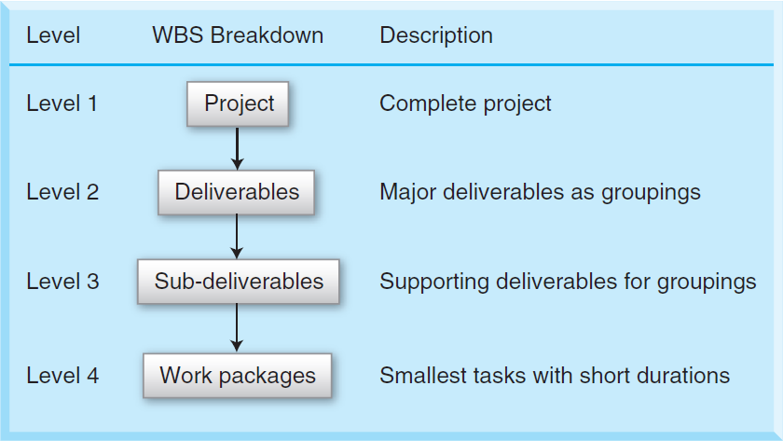
WBS

Slide 13
WBS
Work packages
Small project activities possibly with very short durations with definable results.
In some complex projects, work packages may be at a lower level, say Level 5 or Level 6.
The smallest level in a project that can be monitored, managed, and controlled by a project manager effectively.
The time frame for a work package may be 40 hours or 4 weeks depending upon the size and complexity of the project.
A work package can be used in a project in a variety of ways including in cost estimation and scheduling.

Slide 14
Creating WBS
A good scope document and requirements documentations with good input from all stakeholders; and
Availability of organizational process assets including project policies, procedures, and historical information.
Consider:
Cost and scheduling constraints
Project scope Lead time of equipment
Technology, Quality, and other performance criteria
Outsourced and contracted activities
Milestones and other objectives of the project
Reporting and other communication methods
Responsibilities and accountabilities of the project team

Slide 15
Delivery-based WBS
List the committed deliverables
Decompose the committed deliverables into groups of activities
Decompose each of those groups of activities into activities
Identify the supplementary deliverables
Add the supplementary deliverables as activities to the WBS
Evaluate all activities for optimum hierarchical planning
Validate WBS

Slide 16
Delivery-based WBS
Level | WBS Element | Work Breakdown
Level 1 | 1 | New Logistics with 3PL
Level 2 | 1.1 | Selection of 3PL
Level 3 | 1.1.1 | Request for Proposal (RFP)
Level 4 | 1.1.1.1 | RFP requirements and factors of selection
Level 4 | 1.1.1.2 | RFP to all transportation carriers
Level 4 | 1.1.1.3 | Contact all transportation carriers
Level 4 | 1.1.1.4 | Receive all transportation carriers response to RFP
Level 4 | 1.1.1.5 | Select RFP
Level 4 | 1.1.1.6 | Send 2nd RFP to down selects
Level 4 | 1.1.1.7 | Receive RFP response from down selects
Level 4 | 1.1.1.8 | Final Cut selection
Level 4 | 1.1.1.9 | Interviews
Level 4 | 1.1.1.10 | Selection of the transportation carrier
Level 4 | 1.1.1.11 | Transportation carrier Award

Slide 17
Creating WBS
Lifespan-based
Take into account the project process for a particular type of project.
The major phases of either the traditional or iterative SDLC can be used as Level 2 with the title of the project as Level 1.
Follow the previously described delivery-based structure method.

Slide 18
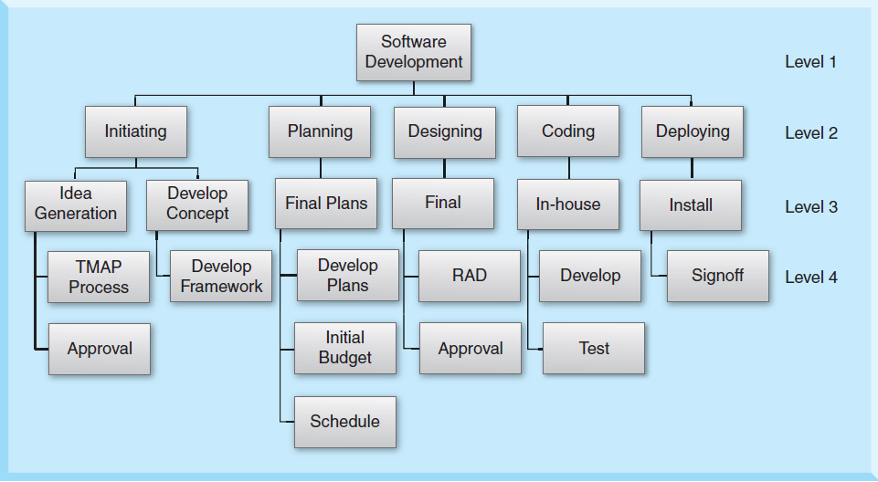
Creating WBS

Slide 19
WBS Dictionary
A useful resource for project management
Describes the WBS element in detail
Should be consulted before commencing any activity in order to ensure that proper standards, procedures, and quality control measures are being followed
Has to be changed whenever the WBS is changed.

Slide 20
WBS Dictionary
Project title: 3PL logistics project
WBS Element: 1.1.1.9 - Interviews
Associated Activities: 1.1.1.8 - Final Cut selection and 1.1.1.10 - Selection of the transportation carrier
Milestones: 1.1.1.11 - Transportation carrier Award
Responsible person: Ms. Brenda Jackson
Start Date: 3/12/12 | End Date: 3/20/12
WBS Element Description: At least three (3) 3PL partners will be selected as potential partners in WBS element 1.1.1.8. Out of the three potential partners, one will be selected to be the 3PL business partner. The following categories will be used to assess the potential capabilities of the 3PL partners during the presentation and interviews: Cost Services including remote depots, security, scalability, availability, delivery metrics; reverse logistics, etc Technology Performance including on-time delivery, inventory carrying rate, delivery quality Quality including ISO certification, storing inventory, packaging, etc Logistics software and intelligence General information and references

Slide 21
Responsibility Matrix
Task | Rob | Mark | Doug | Molly | Peter | Jim | Maria
Identify target customers | R
Identify challenges & opportunities |  | R | S
Perform competitive analysis |  | S | R
Perform SWOT analysis |  | S | R | S
Identify product features |  |  |  | R
Identify advertising medium |  |  |  |  | R | S
Create advertisement |  |  |  |  | S | R
Post on company website |  |  |  |  |  |  | R
Monitor advertisement responses | R |  |  |  |  |  | S
R: Responsible team member; S: Supporting team member

Slide 22
RACI
Task | Rob | Mark | Doug | Molly | Sam | Rich | Kim
Identify target customers | A | R | R |  |  | C
Identify challenges & opportunities |  | A | R |  |  |  | I
Perform competitive analysis |  | A | R |  |  | C
Perform SWOT analysis |  | A | R | R |  |  | I
Identify product features | A |  |  | R | R
Identify advertising medium | A |  |  |  | R | C | I
Create advertisement | A |  |  |  | R | C | I
Post on company website | A,R |  |  |  |  | C
Monitor advertisement responses | A |  |  |  |  |  | I

Slide 23
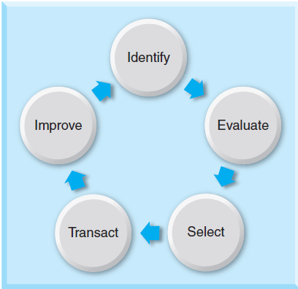
Procurement process

Slide 24
Category | Weight | Sub weight | Score (1-5)* | Weighted Score
Expertise Technical expertise Process expertise R&D expertise | 20 | 10 5 5 | 5 2 3 | 10 2 3
Finance Debt Financial Ratios | 10 | 5 5 | 5 3 | 5 3
Management capability Project Management Process Management General Management | 10 | 5 3 2 | 5 3 2 | 5 1.8 0.8
Quality commitment Quality Awards Certifications Sigma TQM | 20 | 5 5 5 5 | 1 5 2 5 | 1 5 2 5
Cost structure Cost comparisons Cost control efforts | 20 | 10 10 | 4 4 | 8 8
Delivery Promised date reputation Lead-time requirements Responsiveness | 10 | 5 3 2 | 5 3 3 | 5 1.8 1.2
Recognition Community Support Well known Trusted | 10 | 2 3 5 | 3 3 5 | 1.2 1.8 5
Total | 100 |  |  | 75.6
Scorecard
The weighted score is calculated as follows:
For example for the category Expertise in Table 10-3:
Weighted score for Technical Expertise = (5 out of a maximum of 5 points) = 1.0 * sub weight of 10 = 10
Weighted score for Process Expertise = (2 out of a maximum of 5 points) = 0.4 * sub weight of 5 = 2
Weighted score for Process Expertise = (3 out of a maximum of 5 points) = 0.6 * sub weight of 5 = 3

Slide 25
Make or Buy
 | A | B | C
1 |  | Make | Buy
2 | No of parts per year | 150,000
3 | Purchase costs |  | $ 1,725,000.00
4 | Fixed costs | $ 120,000.00
5 | Labor costs | $ 250,000.00
6 | Overhead costs | $ 100,000.00
7 | Raw materials cost | $ 950,000.00
8 | Total Costs | $ 1,420,000.00 | $ 1,725,000.00
9 | Cost per unit | $ 9.47 | $ 11.50

Slide 26
Buy or Lease

Slide 27
Summary
Project planning helps project managers to clarify and focus on the development of a project and provides a benchmark against which actual performance can be measured and reviewed.
Planning helps project teams channel their efforts toward achieving project objectives.
Planning is to develop measures that will be used to determine how expectations are to be met.
Planning is to establish policies, procedures, guidelines, and the necessary processes to adhere to them.
Project planning must be flexible to handle unanticipated activities with the scope of a project.

Slide 28
Summary
A planning process involves the scope document that is used to create project tasks and milestones known as the Work Breakdown Structure (WBS). To create a WBS, a number of project factors have to be considered including the scope document and project assets.
The WBS is a documented project plan that is developed from a project scope. This project plan defines all work activities and identifies each activity with the team member who is responsible for performing the activity.

Slide 29
Summary
The WBS is a hierarchical process map of a project with multiple levels. Level 1 is the highest level of the project, which usually is the name of the project. Level 2 is the next level, which consists of main groupings of the project. Level 3 shows supporting sub-deliverables while Level 4 describes the work packages that define the various lowest level activities of the project. When a project is too small in size and scope, project managers use responsibility matrices instead of a WBS.
A contract is a formal agreement between two parties, a contractor and a client, wherein the contractor promises to perform a service and the client is obligated to pay for the service.

Slide 30
Summary
Contracts come in six types: fixed-price, fixed-price incentive fee, cost-plus fixed fee, cost-plus percentage fee, cost-plus incentive fee, and guaranteed maximum-shared savings.
Contracts are used to procure either services from a contractor or products and services from a supplier.
Procurement is to acquire goods and services from a vendor.
A procurement management plan that includes a make-lease-or-buy decision, procurement documentation, selection criteria, and change requests is the output of procurement planning.

Slide 31
Summary
The procurement cycle consists of five stages: identification, evaluation, selection, transaction, and improvement. A request for quote (RFQ), request for proposal (RFP), or request for information (RFI) from the contractor or supplier is often sought by a client.

Slide 32
Class Discussions
Clients and Contractors should always go for a GMS contract.
WBS need not be elaborate and accurate.
Detailed planning is a waste of time.
One should always resort to outsourcing.
IT management should decide on outsourcing.
Outsourcing brings new technology in client companies.

Slide 33
